Slide 1
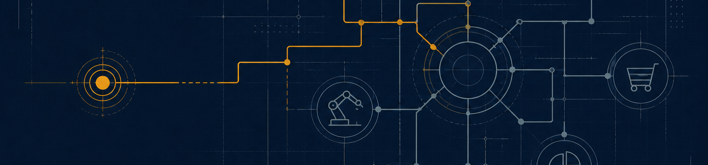
LINKENITE PERSPECTIVES SERIES / ISSUE 05
The Committee You
Cannot See
Why long-cycle technical sellers should treat relationship memory as sales infrastructure.
Research briefing for deep-tech and industrial B2B founders and sellers
August 2026 / Helsinki, EU
LINKENITE PERSPECTIVES / ISSUE 05
1
Notes:
[Sources]
Generated visual: ../images/committee-schematic-hero.png.
No externally sourced non-trivial claim on this slide.

Slide 2
THE COMMITTEE PROBLEM
02
A technical relationship can be an entry point to the buying system.
The first commercial question is not which persona to sequence next. It is what the current relationship can legitimately teach you about the committee: who owns the risk, which evidence is missing, and who else must be able to explain the decision.
A COMMITTEE RECORD
Technical contact / pilot line
A compact record turns a dormant conversation into an orientation point.
CONTEXT
Shared episode
Thermal and integration constraints
SIGNAL
Current change
Program phase; ownership may have moved
JUDGMENT
Next state
Map, verify, reopen, wait, or close
CURRENT PUBLIC GARTNER ANCHORS
5-16
buying-group range across as many as four functions
6-7
average members in public tech-buying guidance
1
relationship can open the map; it cannot replace it
LINKENITE PERSPECTIVES / ISSUE 05
2
Notes:
[Sources]
Gartner 2025 newsroom release: https://www.gartner.com/en/newsroom/press-releases/2025-05-07-gartner-sales-survey-finds-74-percent-of-b2b-buyer-teams-demonstrate-unhealthy-conflict-during-the-decision-process
Gartner tech buying guidance: https://www.gartner.com/en/articles/help-your-tech-buying-team-work-more-effectively
The bridge framing is the briefing's bounded synthesis.

Slide 3
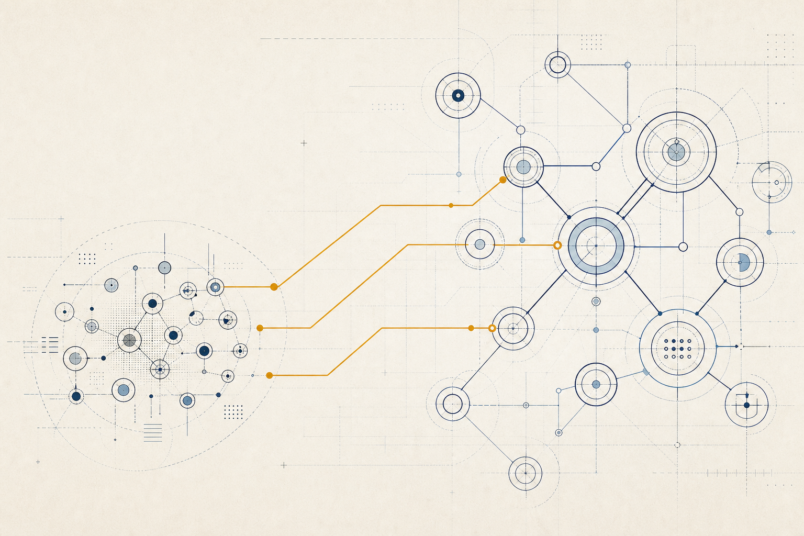
LONG-CYCLE MEMORY
03
Long cycles turn lost context into memory debt.
WHAT DECAYS OVER 12-24 MONTHS
Technical state
Specification, test result, integration constraint
Program state
Phase, timing, ownership, budget, risk
Committee state
Who entered, who blocked, who must validate
Relationship state
Trust, shared episode, permission, last outcome
Dormancy is a state to classify. Retrieve the shared episode, catch up on change, then decide whether the relationship can carry a next question.
LINKENITE PERSPECTIVES / ISSUE 05
3
Notes:
[Sources]
Levin, Walter, Murnighan: https://pubsonline.informs.org/doi/abs/10.1287/orsc.1100.0576
Rondi, Levin, De Massis: https://pubsonline.informs.org/doi/abs/10.1287/orsc.2023.1685
Generated visual: ../images/event-to-committee-map.png.

Slide 4
ENGINEER-TO-ENGINEER TRUST
04
Trust survives when proof can travel.
Industrial trust is not a substitute for performance evidence. It is the willingness to keep evaluating because the claim, the artifact, and the messenger remain coherent under scrutiny.
Q1 2026 INDUSTRIAL BUYER PULSE
Among 303 North American manufacturing decision-makers, early-stage proof preferences were led by independent validation or certification, followed by industry customer references and supplier documentation.
A PROOF STACK
29%
independent validation / certification
CLAIM
What the system can do
20%
customer reference from the industry
ARTIFACT
Test, drawing, specification
VALIDATION
Independent or third-party proof
15%
supplier technical documentation
REFERENCE
Peer in a comparable environment
Directional survey, not a universal market law. The operational message is to make proof inspectable and shareable.
LINKENITE PERSPECTIVES / ISSUE 05
4
Notes:
[Sources]
Doney and Cannon: https://journals.sagepub.com/doi/10.1177/002224299706100203
Zhang, Viswanathan, Henke: https://openurl.ebsco.com/fulltext/gcd%3A59456768
Kula Partners / InnovateMR Q1 2026: https://kulapartners.com/industrial-buyer-pulse/q1-2026/

Slide 5
BRIDGE / COMMITTEE ORIENTATION
05
One technical contact is a bridge, not a buyer.
RELATIONSHIP RECORD
ASK FOR ORIENTATION
Former pilot-line contact
01
What changed?
Specification, phase, ownership, risk
CONTEXT
Shared episode
02
Who else is involved?
Thermal / integration review
Engineering, operations, quality, procurement
SIGNAL
Reason to reopen
Program phase may have changed
03
What proof is missing?
NEXT STATE
Owner's judgment
Artifact, reference, test, pilot
Ask for orientation; do not pitch
04
What is permissible now?
Reopen, map, learn, wait
The first note should make it easy for the contact to correct the seller's memory, name the next stakeholder, or decline without pressure.
LINKENITE PERSPECTIVES / ISSUE 05
5
Notes:
[Sources]
Levin, Walter, Murnighan: https://pubsonline.informs.org/doi/abs/10.1287/orsc.1100.0576
Rondi, Levin, De Massis: https://pubsonline.informs.org/doi/abs/10.1287/orsc.2023.1685
The record and questions are illustrative synthesis.

Slide 6
CONFERENCE RELATIONSHIP CAPITAL
06
Conferences compound when the context survives the event.
WHAT THE TRADE-FAIR RESEARCH SUPPORTS
Social exchange
Supports satisfaction and commitment in B2B trade-fair relationships.
Information exchange
Can strengthen trust and relationship quality, especially when the product matters.
Event execution
Staff proactivity, focus, and follow-up affect networking and lead efficiency.
The event should end with a relationship record: shared technical question, peer context, evidence requested, and next permission.
LINKENITE PERSPECTIVES / ISSUE 05
6
Notes:
[Sources]
Bello et al.: https://www.sciencedirect.com/science/article/abs/pii/S0019850114001771
Gopalakrishna and Williams: https://www.sciencedirect.com/science/article/pii/016781169290018G
Silva, Moutinho, Vale: https://www.tandfonline.com/doi/abs/10.1080/10496491.2021.2009087
Generated visual: ../images/event-to-committee-map.png.

Slide 7
OPERATING LOOP
07
The system should improve the next committee decision.
A light operating layer is enough: retrieve the episode, verify what changed, map the stakeholders and proof gap, choose the next permissible move, and record the new state.
COMMITTEE-MEMORY LOOP
01
Retrieve
02
Verify
03
Map
04
Record
Last credible technical episode
What changed since then?
Who must accept the decision?
What is the next state?
THE RECORD STAYS COMPACT
Context
The prior problem, evidence, and people
Signal
The current change worth reviewing
Judgment
Reopen, map, learn, wait, or close
LINKENITE PERSPECTIVES / ISSUE 05
7
Notes:
[Sources]
Operating loop is the briefing's synthesis, bounded by dormant-tie research: https://pubsonline.informs.org/doi/abs/10.1287/orsc.1100.0576
No new externally sourced statistic on this slide.

Slide 8
HONEST LIMIT / OPERATING COMMITMENTS
Make the committee legible.
Relationship memory is sales infrastructure for long-cycle markets.
Treat technical relationships as compact, current records - not dormant names.
Refresh the shared episode before asking for attention.
Use one contact to map the committee, not to pretend the committee is simple.
Make proof portable, peer-verifiable, and explicit about its limits.
Record the next committee state after every meaningful interaction.
Start with ten relationships. Write down the last technical episode, the change, the missing stakeholder, and the next permissible move.
LINKENITE PERSPECTIVES / ISSUE 05
8
Notes:
[Sources]
Closing synthesis from Issue 05.
Research register: ../SOURCES.md

