Slide 1

LINKENITE PERSPECTIVES SERIES / ISSUE 02
The Relationship
Pipeline
What founder-led B2B service sellers can learn from dormant ties, referrals, and professional networks.
Research briefing for founder-led B2B sellers
August 2026 / Helsinki, EU
RELATIONSHIP ATLAS / ISSUE 02
1
Notes:
[Sources]
Generated visual: relationship-atlas-hero.png

Slide 2
THE PROPOSITION
02
Make the network legible before making it larger.
The first commercial question is not how many people can be reached. It is which relationships already carry enough context to deserve a decision.
A RELATIONSHIP RECORD
Former client / 2021
The useful record is not a name. It is a compact explanation of why a conversation could make sense now.
CONTEXT
Shared episode
Worked together on a transformation programme
SIGNAL
Reason to look again
Role change, returned problem, or relevant trigger
JUDGMENT
Next state
Ask · refer · wait · close
EVIDENCE THAT CHANGES THE DECISION
95%
out of market at a given moment
2.7x
benchmark gap for top prospectors
3
remember · catch up · align
RELATIONSHIP ATLAS / ISSUE 02
2
Notes:
[Sources]
Claims and citations: references 1, 2, 3, and 6 in relationship-atlas.html.

Slide 3
COVERAGE / MARKET TIMING
03
The pipeline problem is often not reach. It is coverage.
WHAT VISIBILITY UNLOCKS
01
Changed role
A familiar person may now own a different problem.
02
Returned problem
An old thread can become relevant when timing changes.
03
Peer introduction
A former client may be a bridge, not just an account.
A large network is only useful when its state can be seen.
The opportunity is not a bigger cold list. It is clearer coverage of relationships already carrying context.
RELATIONSHIP ATLAS / ISSUE 02
3
Notes:
[Sources]
Generated visual: relationship-atlas-hero.png. Claim is synthesis of source report.

Slide 4
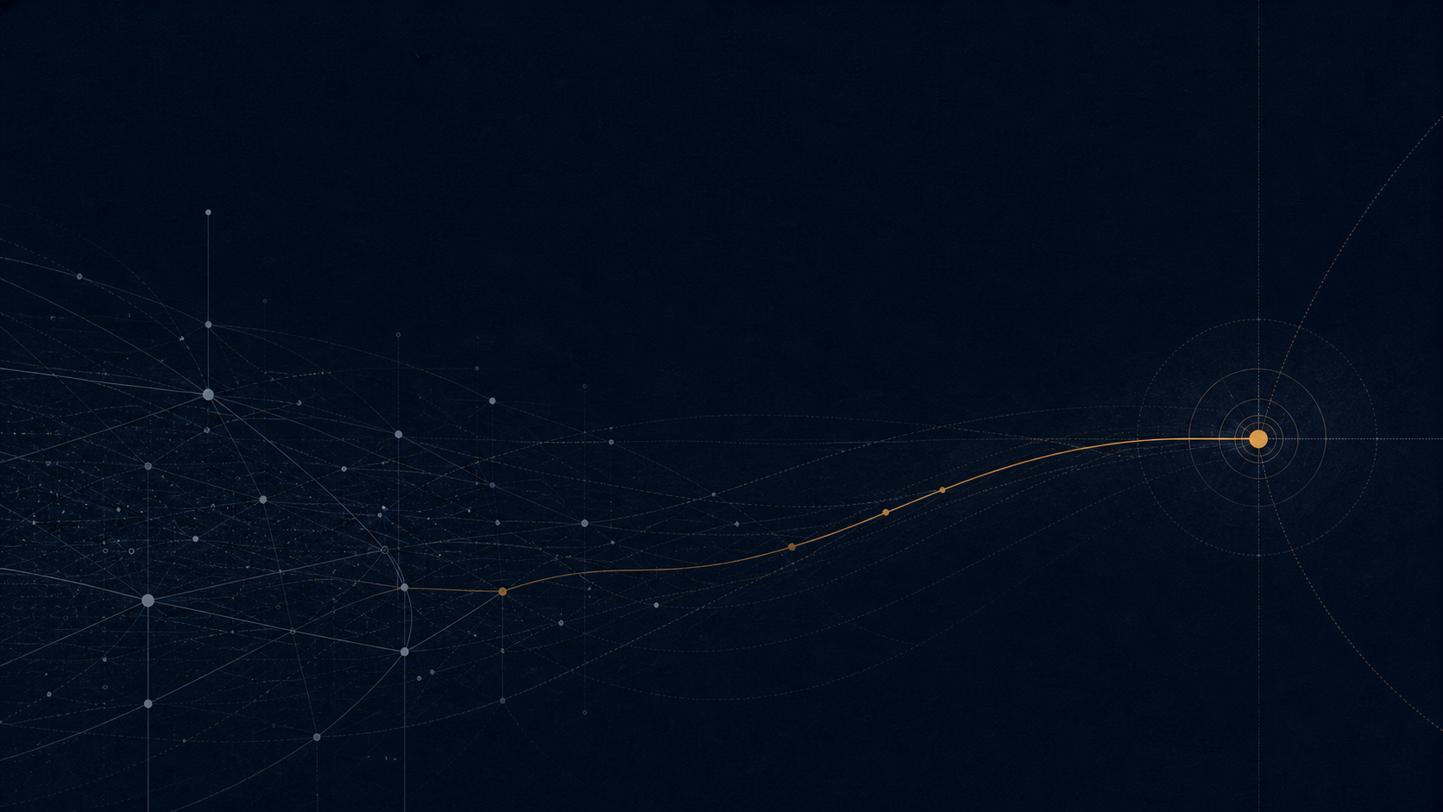
DORMANCY / RECOVERABLE CONTEXT
04
A dormant relationship is not a cold lead with a longer history.
A dormant relationship still has a usable past.
The task is not to pretend the gap did not happen. It is to use the shared episode as a respectful starting point.
01
Remember
Name the shared context.
02
Catch up
Offer a current reason to reconnect.
03
Align
Leave room for their priorities—or a no.
Dormancy alone is a poor proxy for commercial worth; context quality and present relevance do the real work.
RELATIONSHIP ATLAS / ISSUE 02
4
Notes:
[Sources]
Generated visual: relationship-atlas-dormant.png. Claim and source: reference 2 in relationship-atlas.html.

Slide 5

REVIEW / PERMISSIONED ACTION
05
The right workflow makes judgment visible before a message exists.
A REVIEW CARD BEFORE A MESSAGE
SURFACED BECAUSE
Former client · new operating remit
RELEVANCE
A question about scaling the delivery model
PERMISSION CHECK
No active thread; low-pressure re-opening
NEXT STATE
Ask a question / wait for signal
THE OWNER CAN CHOOSE
APPROVE
EDIT
SKIP
The reason is specific enough to send.
The context is useful, but the note needs judgment.
The relationship is not ready or relevant.
RELATIONSHIP ATLAS / ISSUE 02
5
Notes:
[Sources]
Generated visual: relationship-atlas-review.png. Workflow is adapted from relationship-atlas.html.

Slide 6
MEMORY / COMPOUNDING
06
The system compounds by making the next decision easier.
Cold volume repeats by replacing names that did not move. Relationship work preserves context so the next action can be more specific.
COLD ACQUISITION
RELATIONSHIP REACTIVATION
STARTING MATERIAL
Names with limited shared history
Former clients, colleagues, referrals, prospects
FIRST QUESTION
Who fits the target profile?
Why might this conversation make sense now?
USEFUL SIGNAL
Reply, meeting, conversion
Change, timing, relevance, permission
MEMORY CREATED
Performance by segment or message
A clearer relationship state and next action
TYPICAL FAILURE
Volume substitutes for learning
Automation outruns judgment
They are complementary motions. The design question is where memory is captured—and who is allowed to decide the next move.
RELATIONSHIP ATLAS / ISSUE 02
6
Notes:
[Sources]
Process diagram is a print-safe native shape reconstruction of the source infographic.

Slide 7
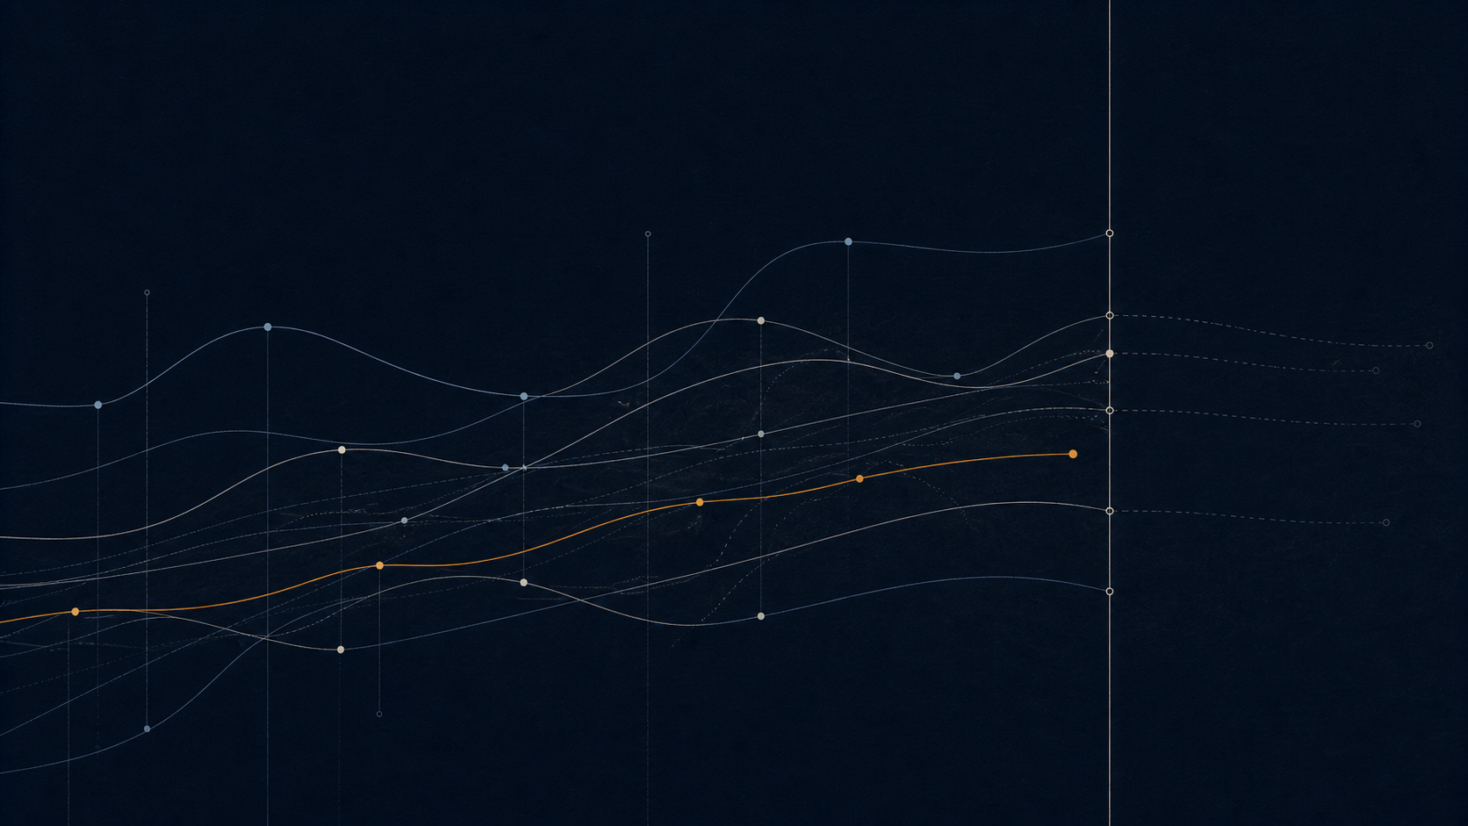
LIMITS / PERMISSION
07
The evidence supports a disciplined layer of growth, not a revenue guarantee.
GUARDRAILS FOR A HUMAN SYSTEM
DO NOT INFER
Dormant does not mean receptive.
Context is a reason to consider—not evidence of intent.
DO NOT PROMISE
Research is not a revenue guarantee.
The mechanism creates coverage and judgment, not certainty.
DO NOT HIDE
Automation can increase error.
Keep the surfaced reason and the owner’s decision visible.
DO NOT COLLAPSE
Reactivation is one layer of growth.
Keep acquisition and relationship work legible as separate motions.
The test is simple: can the owner see why this person was surfaced, decide whether contact is warranted, and preserve the other person’s ability to decline?
RELATIONSHIP ATLAS / ISSUE 02
7
Notes:
[Sources]
Generated visual: relationship-atlas-boundary.png. Limits are from relationship-atlas.html and references 7-8.

Slide 8
LEGIBILITY / OPERATING COMMITMENTS
Make the network legible.
Relationships become commercially useful when they become visible, current, and worthy of judgment.
Treat the network as relationship inventory, not a lead list.
Reopen with memory and relevance, not a generic pitch.
Classify the outcome, not just the reply.
Keep reactivation and acquisition visible as separate motions.
Protect human judgment at the point where a relationship becomes a message.
Start with ten names. Let the thread decide whether the next move is a note, a question, a referral, or no message.
RELATIONSHIP ATLAS / ISSUE 02
8
Notes:
[Sources]
Closing synthesis from relationship-atlas.html.

